Slide 1
Unit 3: Text-Based Programming
Lesson 8

Slide 2
Making Choices
Making choices in a computer program is known as selection, and involves working out whether something is True or False. If it’s True, you take an action; if it’s False you don’t (and perhaps you take a different action).
Example: “Is the height of the cliff less than the height I can fall and survive?” True – Jump off, you will be fine. False – DON’T JUMP!

Slide 3
True or False
Computers make choices by determining if the value of a statement is True or False. This is known as evaluation. If the statement is True then the program will run the next instruction, otherwise it won’t. You can try out some evaluations by using the REPL or Shell. They allow you to run one line of code at a time and see the result immediately. It’s a great tool for testing to see how something works, and it remembers any values from the last program that you ran. Tip: REPL stands for “Read-Eval-Print Loop”. it reads one line of code, evaluates it, prints the result and loops back to the start.

Slide 4
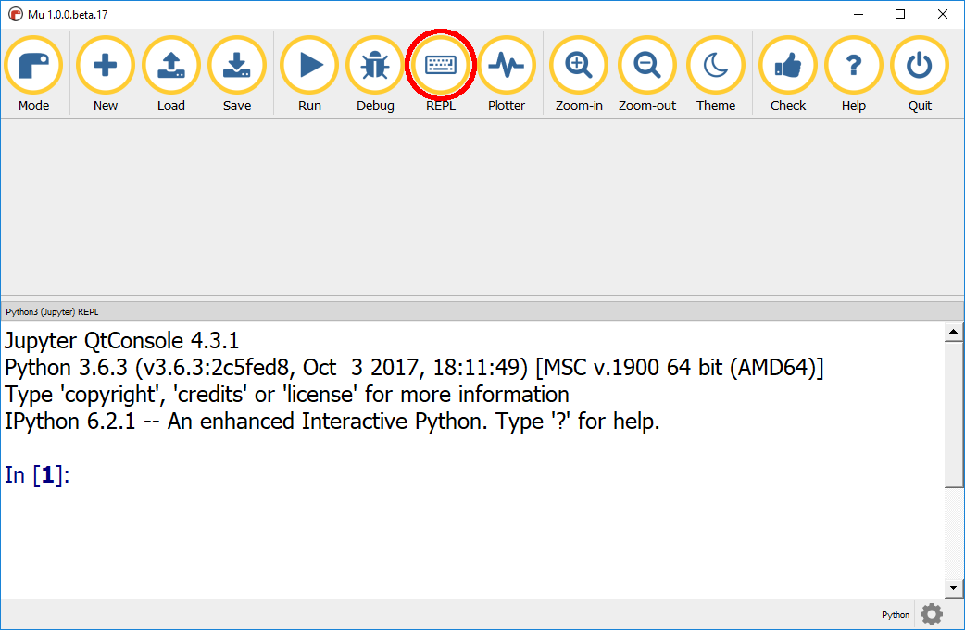
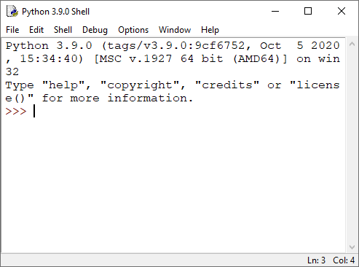
click on the “REPL” button in Mu. When you open IDLE you are in the Shell

Slide 5
Try it!
Enter the following into the REPL or Shell window and press Enter: 1 == 1 Note: the double == operator means “is this equal to?” as opposed to a single = which follows a variable and means “make this equal to”.
== means evaluate
= means assign When you press Enter, True will be displayed. This is because it’s true that 1 is equal to 1.

Slide 6
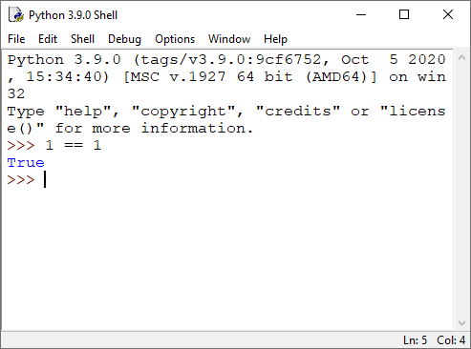

Slide 7
Try entering 1 == 2. False will be displayed, because it’s false that 1 is equal to 2. Enter these evaluations and see if you can predict whether the outcome will be True or False. 1 < 2 The operator < means less than. Ask yourself is 1 less than 2? If the answer is yes then the statement is true. 1 > 2 > means greater than, so is 1 greater than 2?

Slide 8
Now, enter the following:
1 != 2 != is the operator for is not equal to, which means this statement means is 1 not equal to 2. != is the opposite of the == operator.

Slide 9
Whats do you think will be the result of: 1 < 1 This evaluates as false because 1 is not less than 1. However, instead of <, you can use <= test if something is less than or equal to: 1 <= 1 This would give True. You can evaluate other data types, not just integers (whole numbers) as you have been doing.

Slide 10
String Evaluations
Try some string evaluations: "hi" == "bye" "hi" != "bye"
What do you think the result would be for: "a" < "b" Run it in the REPL or Shell and observe the result.
You can close the REPL by clicking on the REPL button

Slide 11
If then statements
Now that you have an understanding of how to make computers test whether something is True or False, you can use this in your programs using if. When a computer is asked to make a choice, it carries out a process like this: if this statement is true then I will run this code This is known as selection. Your job as the programmer is to provide: 1. the statement which will be evaluated as either true or false, and 2. the code which will be performed if the statement is true.
As you are aware from Unit 2, the instruction is known as an if–then and is one of the most commonly used structures in programming. A version of the if–then exists across all general purpose programming languages.

Slide 12

The syntax of an if–then in Python looks like this:
Between the if and the : is the code which will be evaluated, this is known as the condition, namely statement == True. Indented under the : is the code which will be run if the statement is equal to True, e.g. print("do this").

Slide 13
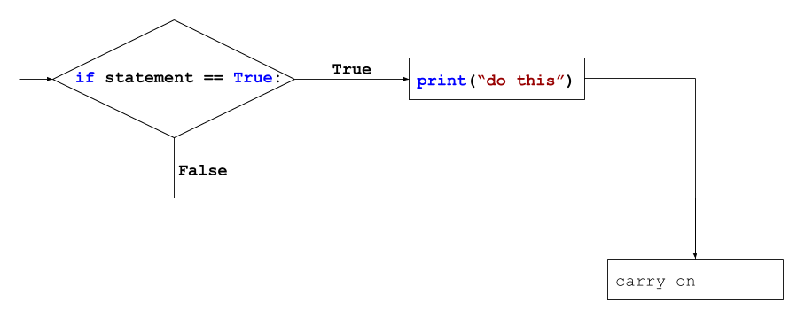
Flowcharting if, then

Slide 14
Try it!
Let’s try it by creating a simple program which will talk back to you when you type certain phrases. For example, if you say “hi” it will say “hello”.
Create a new program, save it in your activities folder ifs

Slide 15
Create an If Statement
Add the following code, which will use input to get some text from the user and store it in a variable called phrase.
Use an if statement to check if the phrase typed by the user is equal to “hi”.
Note: remember that a double equals sign is used when testing whether two things are equal.

Slide 16

Indented under your if statement, add the code to print out “hello”.
Note: the indentation (gap) before print is very important. This is how Python knows what code to run if the statement is True. When you pressed enter after the colon : your IDE should have automatically indented the cursor for you, if not you can use the TAB key to create an indent. If it didn’t indent properly then you have an error in your if statement.
Run your program and enter “hi” when prompted. You should see the message “hello”.
If you put a space before “hi”, you won’t see the message “hello”. Why do you think this is?

Slide 17

Run your program and enter “hi” when prompted. You should see the message “hello”.
If you put a space before “hi”, you won’t see the message “hello”. Why do you think this is?

Slide 18
Run your program again but enter a different message. You should notice that you don’t see the “hello” message. The “hello” message will only be shown if your enter “hi”.
Next you will change your program so that it always says “bye” when the program finishes. To have code run after the if, you need to write it without an indent, otherwise Python will still think it is part of the if.
Add a print statement to the very end of your program: Note: there is NO indent before print("bye").

Slide 19

Your program should now look like this.
Run your program a few times. Experiment by entering the phrase “hi” and then different greetings. Do you get the results you expect?
Your program should only say “hello” if you say “hi”, but it should always say “bye”.

Slide 20
Reflection
What real-world situations do you think could be represented by an “if–then” statement? Share your thoughts with a partner.

Slide 21

If-Then-Else
In the previous step you learnt how to use an if–then statement to allow your computer to take an action when a statement was true. It is often really useful to take a different action if the statement is false.
This is done using an if–then–else statement, which works like this: “if this statement is true, then I will run this code, else I will run this other code”
The syntax for an if–then–else in Python looks like this:
Note: The else isn’t indented and is in line with the if. By aligning them, you tell Python that this else belongs to that if.

Slide 22
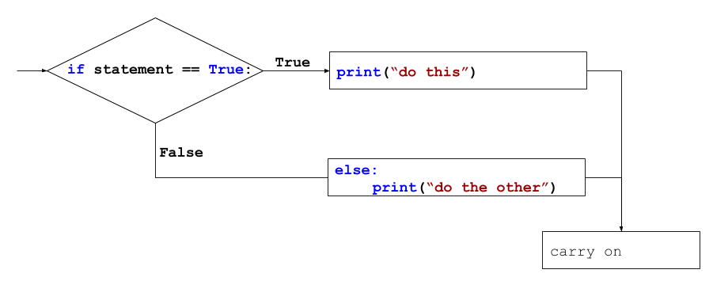

Slide 23

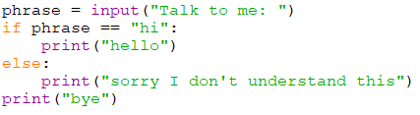
You will now change your program so that if the user enters anything other than “hi”, it replies with “sorry I dont understand this”.
After the code print("hello") add an else and a print indented under the else, like this.
You complete code should look this this: phrase = input("Talk to me > ")
Note: the else is not indented and is in line with the if. This is very important, as the level of indentation tells Python that this else belongs to this if.

Slide 24
Indentation
Indentation is important to Python because it’s how you determine scope. Scope is how Python knows what code belongs to what part of the program. Let’s recap by looking at some code you have already created: phrase = input("Talk to me > ") if phrase == "hi": print("hello") print("bye")

Slide 25
This small program contains one indent: it’s before the code print("Hello") and it is under if phrase == "hi": if phrase == "hi": print("hello") The indentation tells Python that the code print("hello") should only be run if phrase == "hi" is True. Any code that is indented under the if will form part of that if statement’s scope. if phrase == "hi": print("hello") print("this is also part of the if's scope") print("not part of the if's scope")

Slide 26
Look at the program below, where there is another indent: after the else before print("Sorry I don’t understand this"). phrase = input("Talk to me > ") if phrase == "hi": print("hello") else: print("sorry I dont understand this") print("bye")

Slide 27
Using the same scope rules as the if statement, the print statement indented under the else is part of that else statement’s scope. else: print("sorry I don’t understand this") The final print("bye") is not indented under the if or the else, so it is not part of the if or the else. That makes sense as you want this line to run no matter what phrase the user entered. Without the use of indentation, Python would not be able to determine what code to run as part of the if or the else.

Slide 28
Tips for Indentation
Use the Tab key on your keyboard. This will ensure you are using same number of spaces per indent.
Don’t fight with your editor: let it indent code for you where possible, and use the number of spaces it gives you.
Keep your code tidy! If it’s not lined up it’s not going to work.

Slide 29
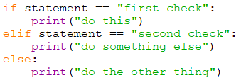
Else If
What if you want to test more than two possibilities, such as whether you entered “hello”, or “bye”, or “no way”? For these scenarios you can use an else if. The syntax for an else if in Python, which abbreviates it to elif, looks like this:
Note: The elif goes in between the if and the else.

Slide 30
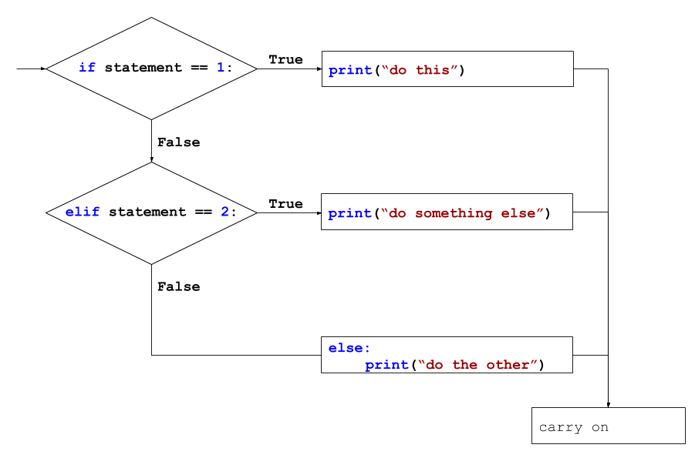

Slide 31

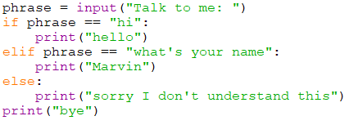
Change your program so that it uses an elif to check if the phrase is “whats your name”, and to reply to that phrase with “Marvin”.
After the code print("Hello"), use an elif and print out a name.
You complete code should look this this:

Slide 32
Portfolio 4 – Confusing Marvin
Can you use the the program from this lesson so that instead of just saying: sorry I dont understand this it includes the phrase you entered? E.g. If you entered “what are you”, the program will respond with: sorry I dont understand 'what are you’
Save your program as your_name_u3_port_4

Slide 33

Sample Output for Portfolio 4
I want the single quotes to show in your output

